Slide 1
Number System

Slide 2
NUMBER SYSTEM:
Number systems are the technique to represent numbers in the computer system architecture, every value that you are saving or getting into/from computer memory has a defined number system.
Computer architecture supports following number systems.
Binary number system
Octal number system
Decimal number system
Hexadecimal (hex) number system

Slide 3
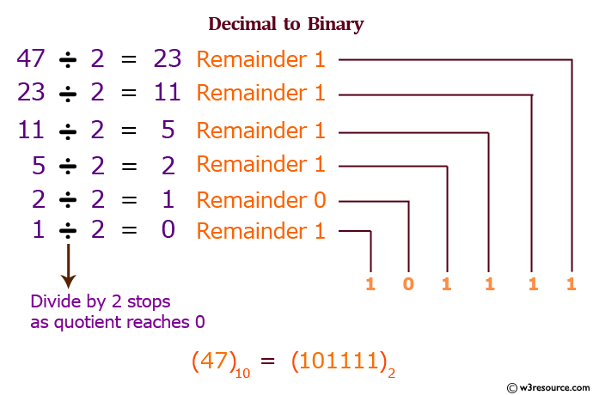
Decimal to Binary Conversion

Slide 4
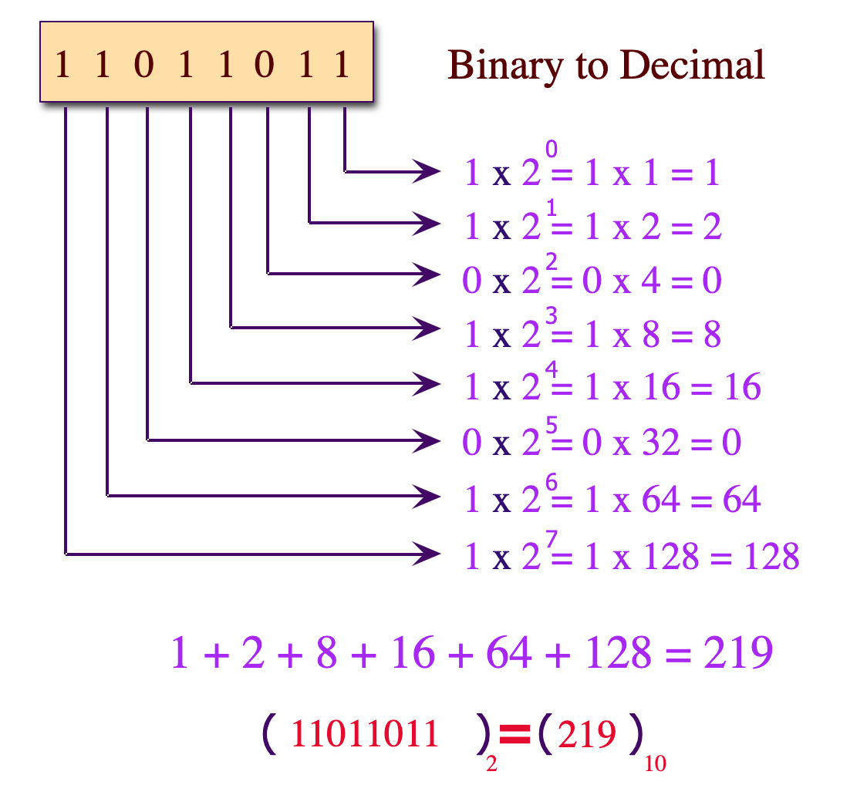
Binary to Decimal Conversion

Slide 5
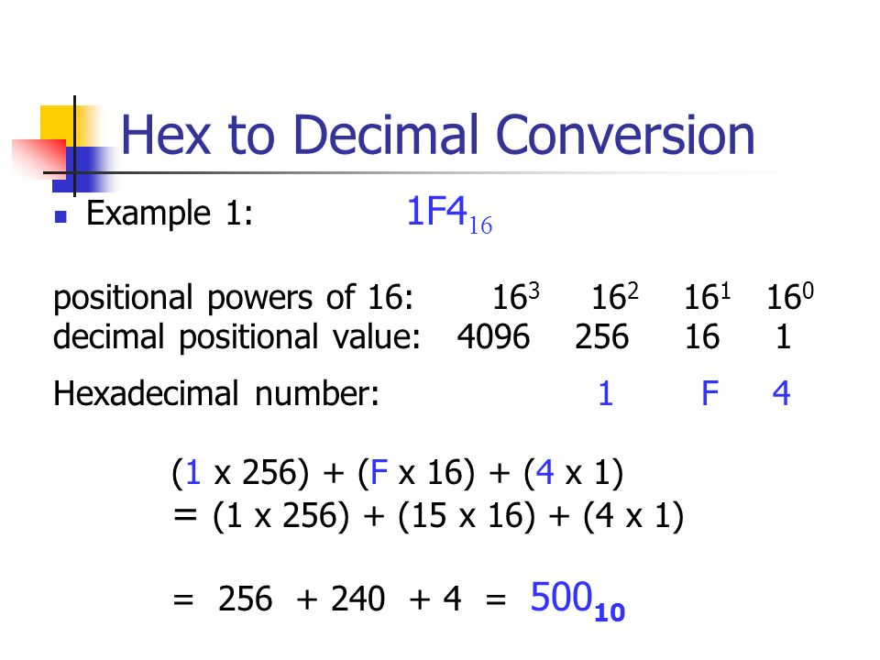
Hexadecimal to Decimal Conversion

Slide 6
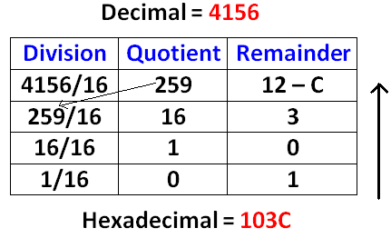
Decimal to Hexadecimal Conversion

Slide 7
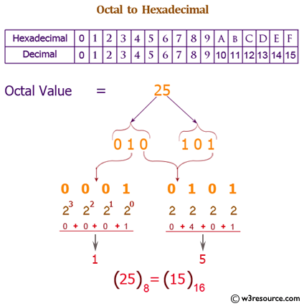
Octal to Hexadecimal Conversion

Slide 8
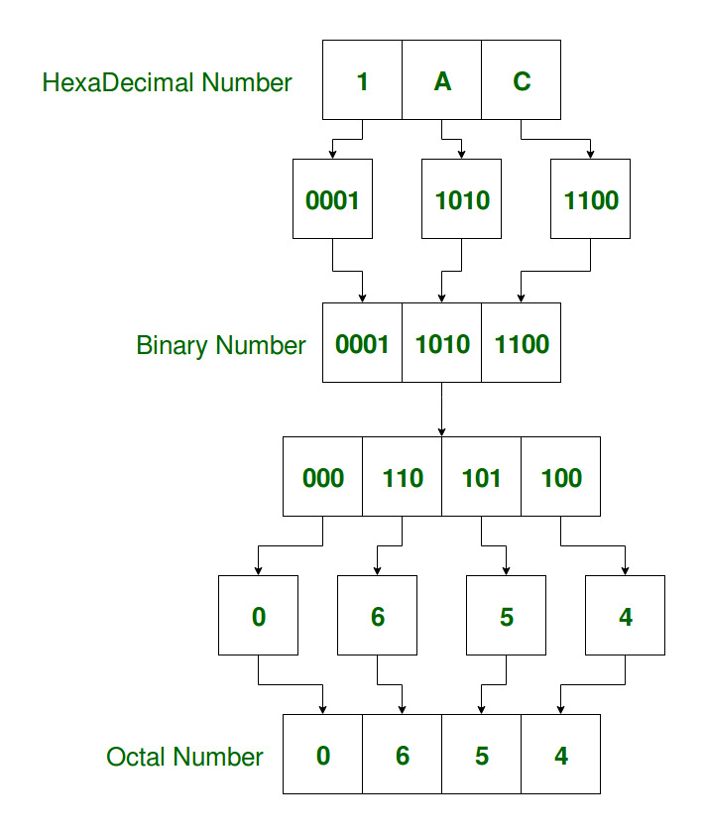
Hexadecimal to Octal Conversion

Slide 9
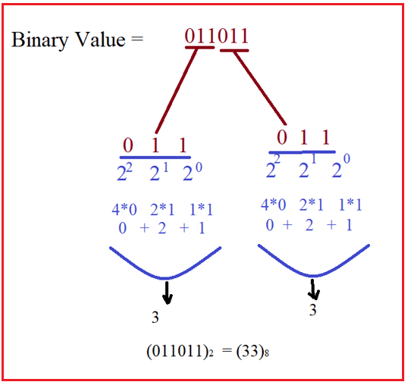
Binary to Octal Conversion

Slide 10
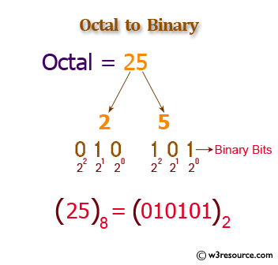
Octal to Binary

Slide 11
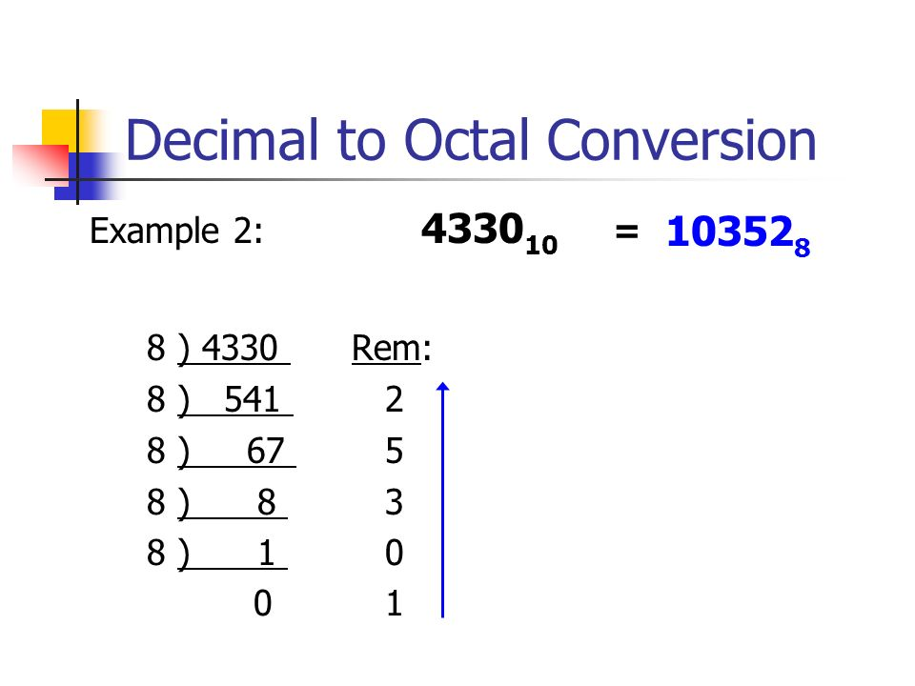
Decimal to Octal Conversion

Slide 12
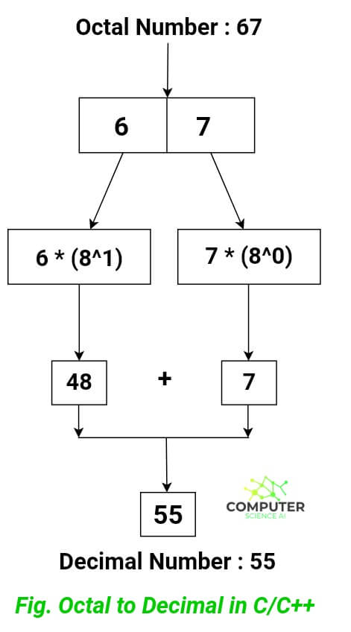
Octal to Decimal Conversion

